Slide 1

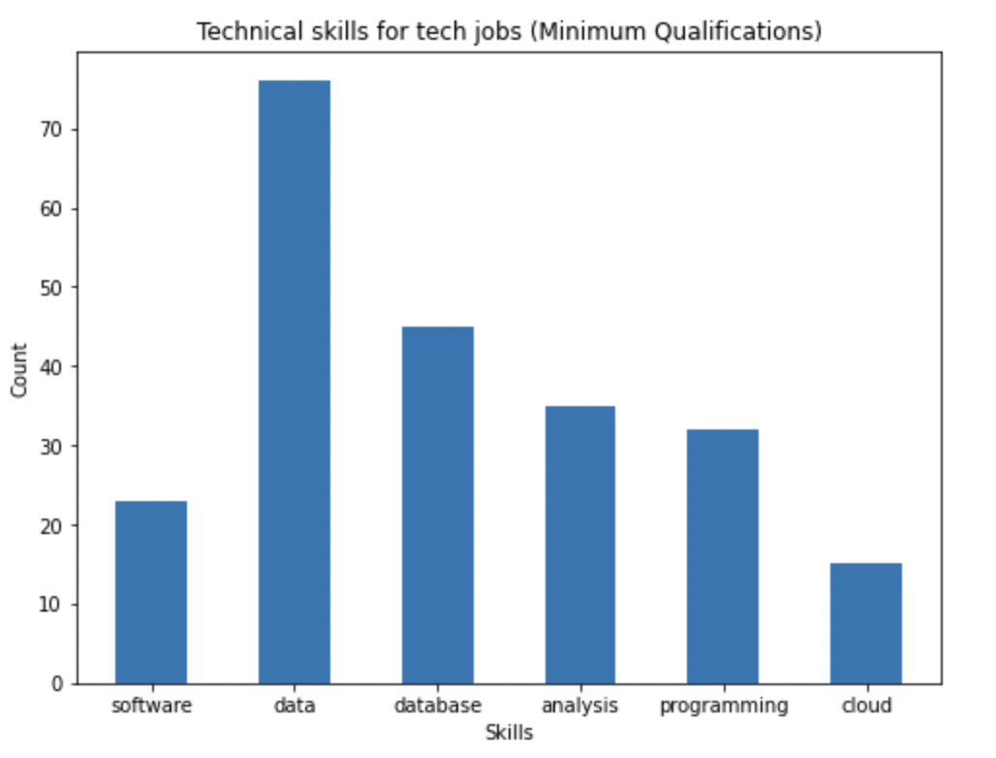
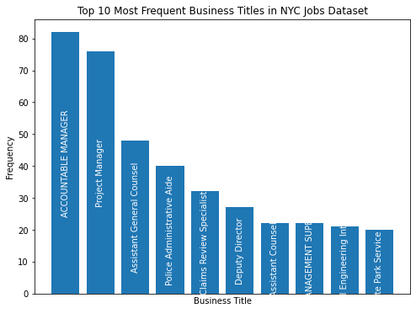
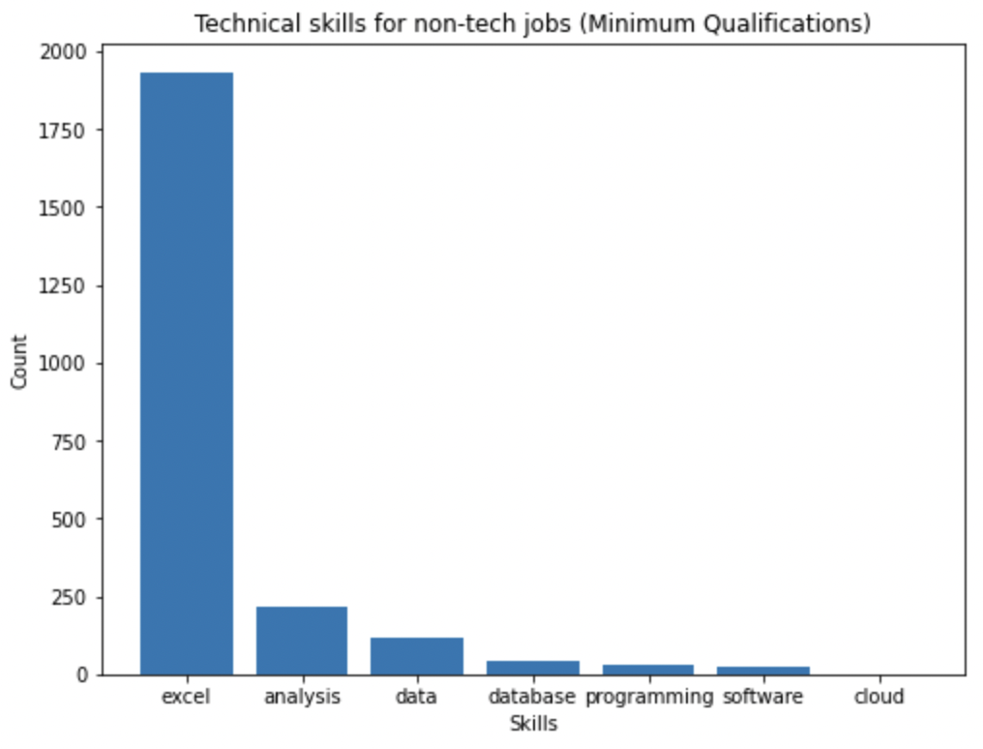
Navigating the New York City job Market Harshitha, Spencer and Sandilya Instructor: Christopher Asakiewicz
INTRODUCTION
New York City has one of the largest job markets in the world, with a diverse range of industries and job titles available. Understanding the job market trends in New York City can be beneficial for job seekers, employers, and policymakers alike.
In this project, from the list of job postings we will explore the most common:
Job titles and industries
Required technical skills and qualifications
Preferred soft skills
The most significant characteristics of each class were determined by computing the probabilities of each feature within that class.
The probabilities are then sorted in descending order to identify the most important features at the top of the list.
To obtain the critical words or tokens of each class, we map the tokens to their corresponding probabilities.
Technical skills were extracted by matching predefined sets of technical skills to the words in each class.
to extract soft skills, we leveraged the TextBlob library, which uses POS-tags to identify adjectives that describe a person's skills or traits.
METHODOLOGY:
For preprocessing, text data was converted into lowercase. Numbers, special and junk characters were removed. NLTK defined stop words were deleted and text was lemmatized
Classification was used to identify necessary skills. Data was organized into job titles, which represent the classes in the classification problem. We opted for multilabel classification as there may be multiple job titles with similar characteristics.
XGBoost Classifier was used to combine outputs from individual decision trees to perform regression or classification. Data was grouped as 80-20 training and testing data. For feature extraction, CountVectorizer was used in a format supported by machine learning algorithms from text datasets.
RESULTS
Bachelor Degrees are the most commonly asked for credentials and are the least likely to require additional experience besides Doctorates.
A high school education can provide a job if you have had substantial experience within the field.
Excel is most required skill for tech and non tech jobs.
Data Analytics skill is observed to be in high demand
Soft skills in non-tech jobs are focused on individual traits and social aptitude with others, while for tech jobs the focus is on mechanical skill/knowledge.
Accountable Manager and Project Manager positions are the most common business titles.
Dept of Environmental protection and Dept of Health/Mental Hygiene are the top 2 agencies with most openings.
http://www.stevens.edu/bia

